Slide 1



NLA Airlines
NORTHERN LIGHTS AIR
MAKING TRAVEL EASY AND MEMORABLE

Slide 2

NLA Airlines
MENTOR
Tali Fulman
PROJECT TEAM
Yuval Elisha
Dana Lurie
Stav Sivilya
Lior Moshe
Ziv Mordoch

Slide 3

NLA Airlines
ABOUT NLA
This project presents an analysis of a customer loyalty campaign conducted by Northern Lights Air (NLA), a Canadian airline.
The campaign, which ran from February to April 2018, was designed to increase loyalty program enrollment and attract new customers.
In this project, our objective was to assess the campaign’s impact on the company from several perspectives, including customer behavior, engagement, and overall business performance.

Slide 4
NLA Airlines
COMPANY PROFILE
Identity
A growing Canadian airline operating both regional and international routes
Core Business Model
The Loyalty Program is the main revenue driver. The strategic goal is to shift from occasional flyers to high Customer Lifetime Value (CLV) customers.
Geographic Presence
Strong operations across Canadian provinces, with key focus on major regions such as Ontario.
Target Audience
A diverse customer base across demographics (education, marital status, etc.)
The key marketing challenge is identifying high-ROI customer segments.

Slide 5
NLA Airlines
CUSTOMER GROWTH & QUALITY ANALYSIS
The 2018 campaign increased customer activity and generated high-quality loyalty members and their contribution to the Airline
To validate this, we analyzed:
Campaign Impact on Activity
Customer Engagement
Customer Retention
Customer Value (CLV)
Our Goal:
To determine not only if the campaign increased signups, but whether it drove meaningful, sustainable business impact

Slide 6
NLA Airlines
SUMMER TRAVEL IMPACT
Number of Flights Booked During Summer
(Post-Campaign)
Growth vs. Pre-Campaign Summer / Previous Period
% of New Members Who Booked Summer Flights
Our Goal:
Evaluate the impact of the 2018 campaign on summer flight activity and customer engagement, focusing on both booking volume and the behavior of newly acquired customers.

Slide 7

NLA Airlines
CUSTOMER GROWTH & QUALITY ANALYSIS

Slide 8
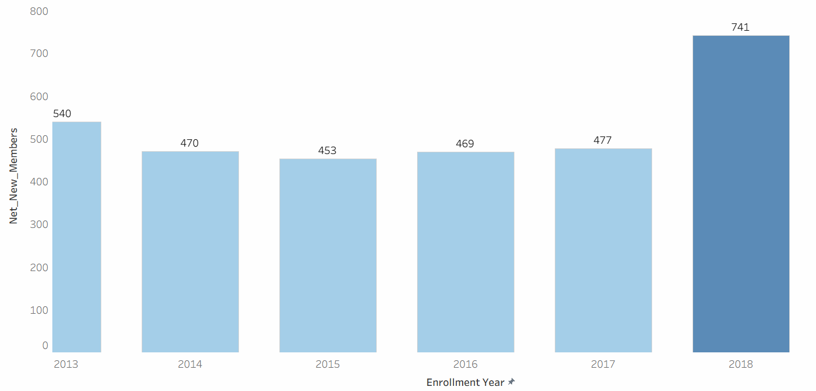
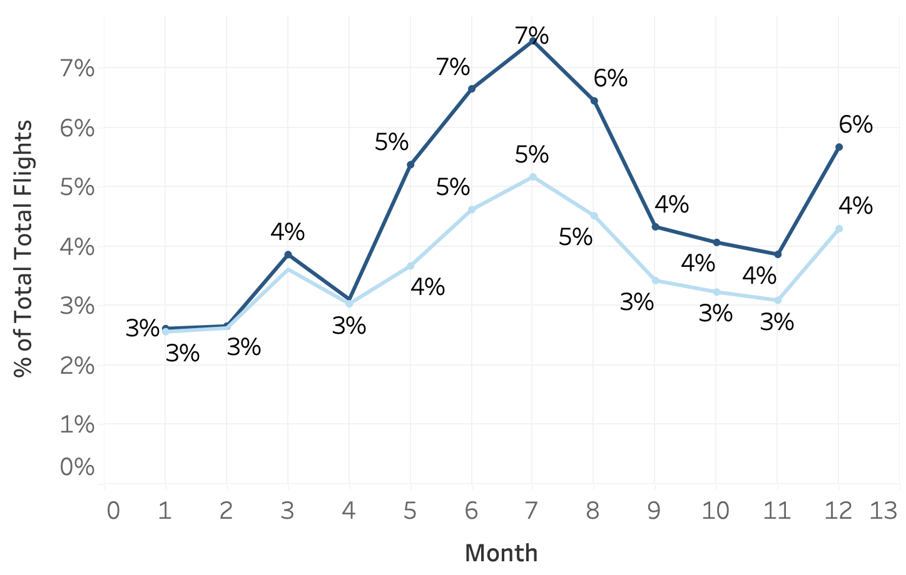
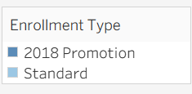
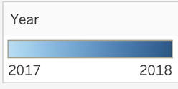
NLA Airlines
Campaign Impact on Activity
Net Enrollment Feb-Apr 2018 vs 2013-2017
Total Flights 2017 vs 2018
Enrollment - Cancellation
We observe a clear increase in both enrollments and flight activity during the campaign period compared to previous years.

Slide 9
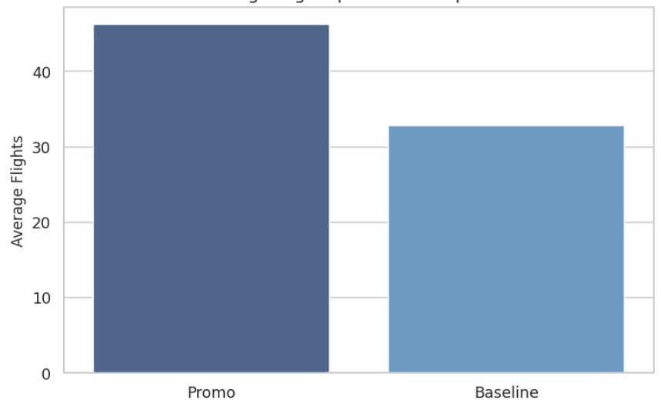
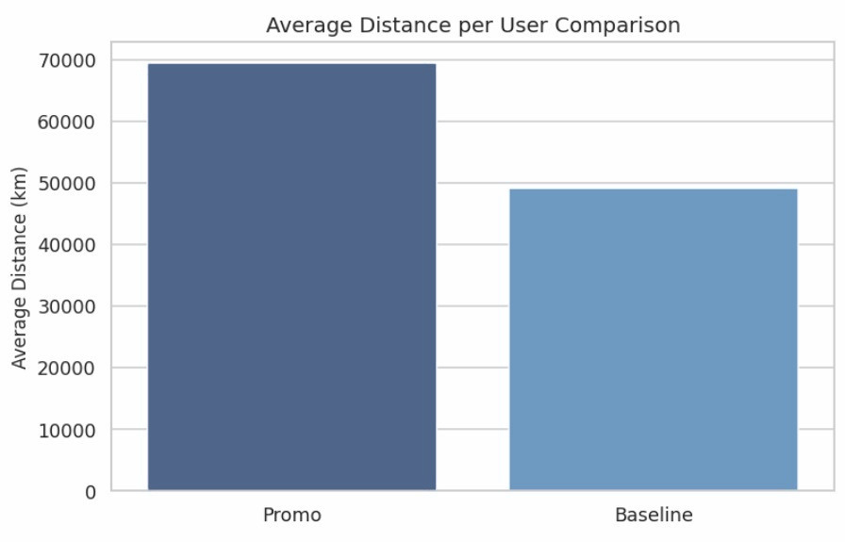
NLA Airlines
Customer Engagement
Average Total Flights
Average Distance Per User Comparison
46
69,386
32
49,061
Promo
Avg Flights per User: 46
Avg Distance per User: 69386
Baseline
Avg Flights per User: 32
Avg Distance per User: 49061
Campaign users demonstrate higher engagement, with more flights and greater travel distance compared to baseline users.

Slide 10
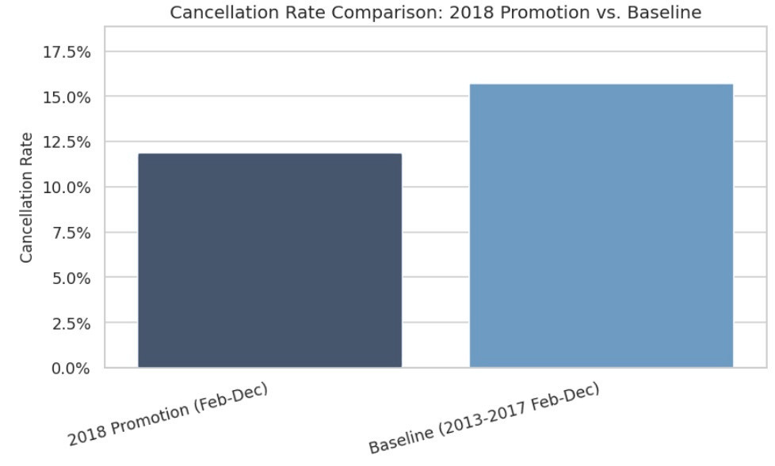
NLA Airlines
Customer Retention
Cancellation Rate Comparison: Feb-Dec 2018 vs 2013-2017
15.7%
11.8%
Early Churn Rate
(<=3 months):
0.00%
Campaign customers show low cancellation rates and no early churn, indicating stable and committed users.

Slide 11
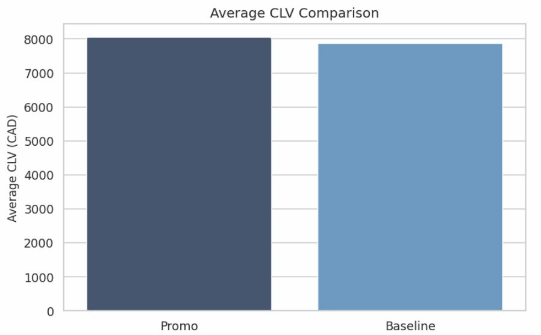
NLA Airlines
CUSTOMER VALUE (CLV)
Average CLV Comparison +▲ 2.1%
8046
(CAD / CDN)
7985
(CAD / CDN)
Campaign users show slightly higher average CLV, suggesting stronger long-term value contribution.

Slide 12

NLA Airlines
SUMMER TRAVEL IMPACT

Slide 13
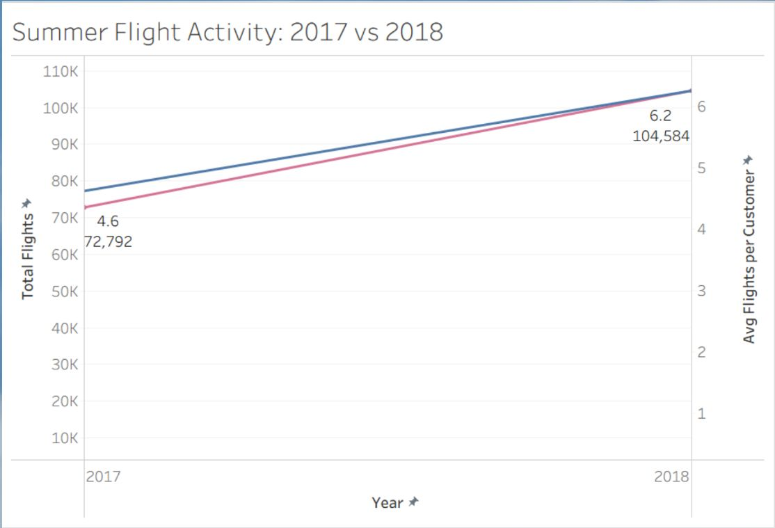

NLA Airlines
POST-CAMPAIGN GROWTH IN SUMMER FLIGHTS
June-Aug 2017 vs 2018
+43% Total Flights
+35% Avg Flights per Customer
Summer flight bookings increased significantly from 2017 to 2018
(June-Aug).
Growth was driven by both more customers and higher activity per customer.

Slide 14
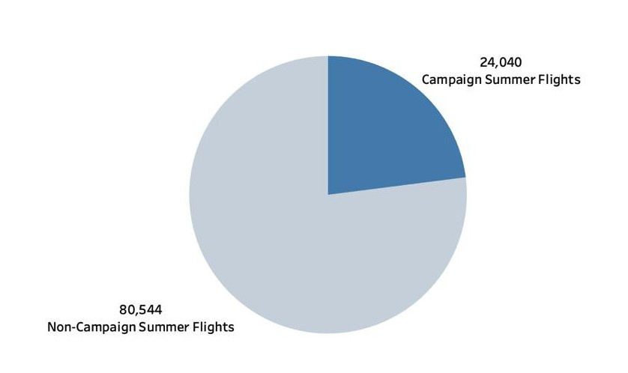
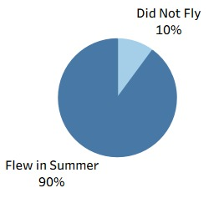
NLA Airlines
NEW MEMBER ENGAGEMENT:
SUMMER FLIGHT ACTIVITY POST-CAMPAIGN
Distribution of Summer 2018 (June-Aug) Flights by Customer Type
Summer Flight Activity Among New Members 2018 June-Aug Campaign
Campaign-acquired members generated over 24K summer flights, contributing significantly to overall activity.
This indicates the campaign drove not only sign-ups, but also real engagement and flight bookings.
The campaign successfully converted new members into active customers, with nearly 90% flying during the summer season.

Slide 15
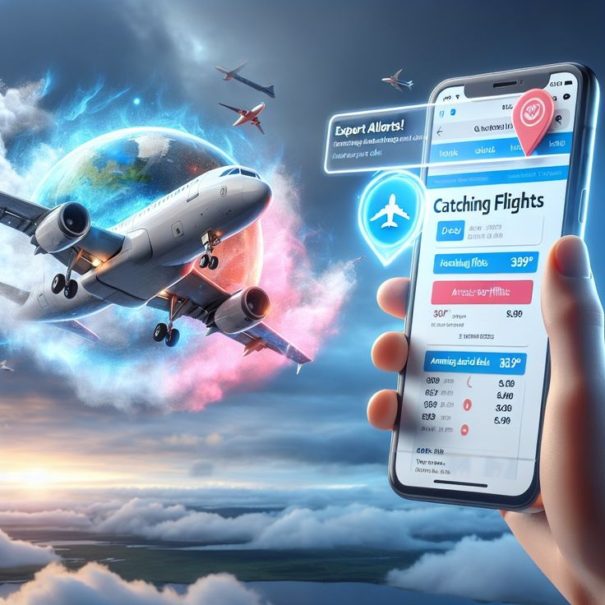
NLA Airlines
Campaign Impact & Success

Slide 16
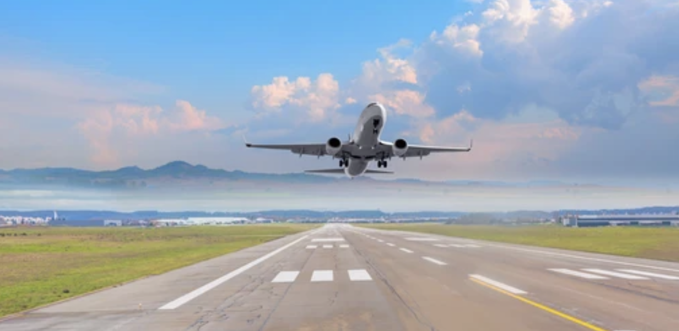
NLA Airlines
The 2018 campaign was successful in driving both customer growth and activity. It attracted high-quality customers who demonstrated strong engagement, with higher flight frequency and travel distance.
In addition, the campaign’s impact extended beyond its duration, with a significant increase in flight activity during the following summer compared to the previous year.
Overall, the campaign proved effective and represents a strong model to replicate in future initiatives.

Slide 17

NLA Airlines
RECOMMENDATIONS

Slide 18
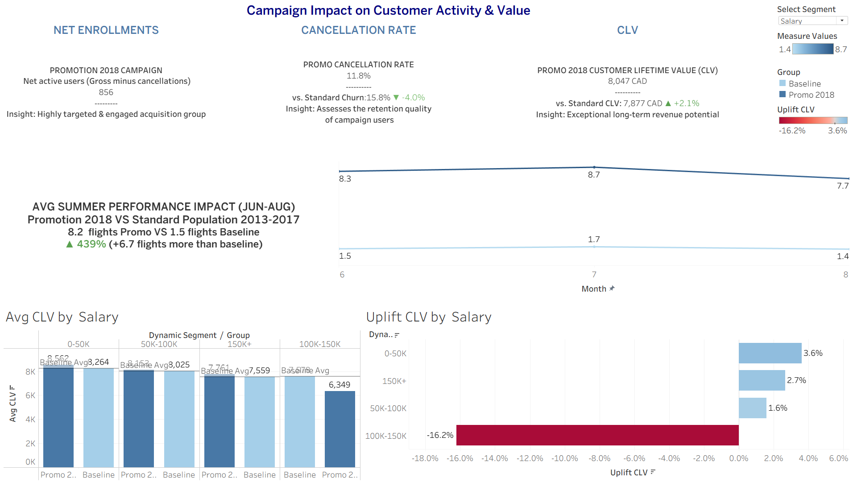
NLA Airlines
RECOMMENDATIONS

Slide 19
NLA Airlines
STRTEGIC RECOMMENDATIONS
Quality Over Quantity – Strong Customer Acquisition
The campaign generated 856 net enrollments, but more importantly delivered higher quality customers than the historical baseline.
Lower cancellation rate (-4%) → stronger retention and reduced churn risk
Higher CLV (+2.1%) → customers are more profitable over time
Behavioral Breakthrough – Extreme Summer Engagement
Promo customers completed 8.2 flights vs 1.5 baseline (+439%) Strong and consistent activity across the entire summer period (Jun–Aug)
Engagement is not only higher – it is structurally different behavior

Slide 20
NLA Airlines
STRTEGIC RECOMMENDATIONS
Segmentation Matters
Not all customers respond to the campaign the same way - and that’s where the real insight lies. While overall performance improved, the impact is clearly driven by specific high-value segments:
Marital Status: Married customers generate strong positive CLV uplift, indicating higher long-term value, while single and divorced customers underperform relative to the baseline.
Income Level: Mid-income customers (0–70K) show the strongest uplift, suggesting an optimal balance between affordability and travel frequency.
Education Level: Customers with Bachelor’s and Doctorate degrees demonstrate higher value, likely reflecting more frequent or higher-value travel behavior.
Loyalty Tier: Highly engaged members (e.g., STAR tier) respond better to the campaign, reinforcing the link between loyalty depth and customer value.
Geography (Province):Campaign performance varies across regions, indicating that geographic targeting can further optimize results.

Slide 21
NLA Airlines
RECOMMENDATIONS
Target What Works
Focus on high value segments (married, mid-income, engaged loyalty members) - not all customers deliver the same impact.
Invest in Value, Not Volume
Reallocate budget toward segments with positive CLV uplift and reduce spend on underperforming audiences.
Turn Loyalty into Leverage
Use personalized bonus and benefits (tier-based rewards, upgrades, family offers) to drive repeat usage and deepen engagement.
Win the Peak Moments
Launch campaigns before peak seasons (e.g., summer) to convert sign-ups into real flight activity.
Drive Immediate Action
Design campaigns that push for early bookings and fast engagement, not just registrations.

Slide 22
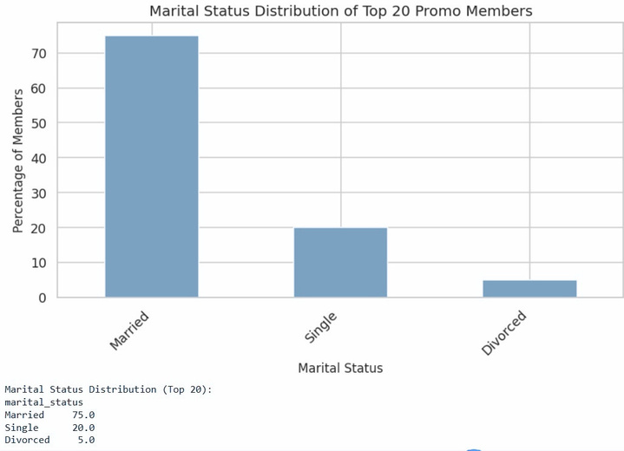
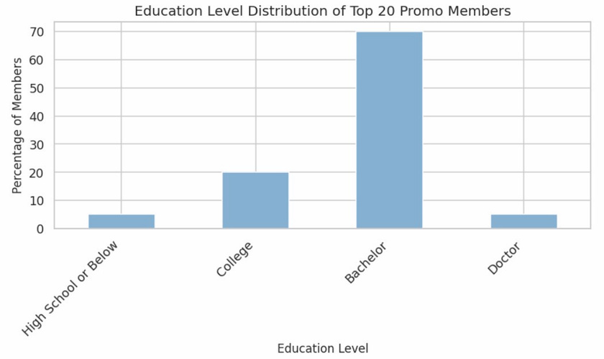
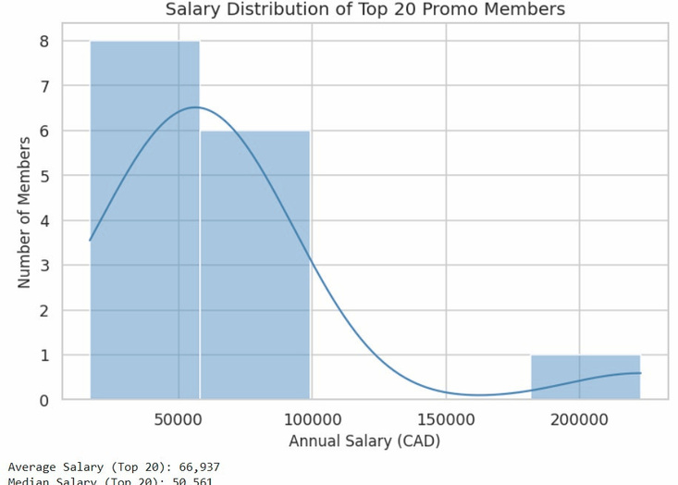
NLA Airlines
Target Audience for Future Campaigns
Instead of targeting broadly, we identified who actually generates value - and focused on those segments.

Slide 23
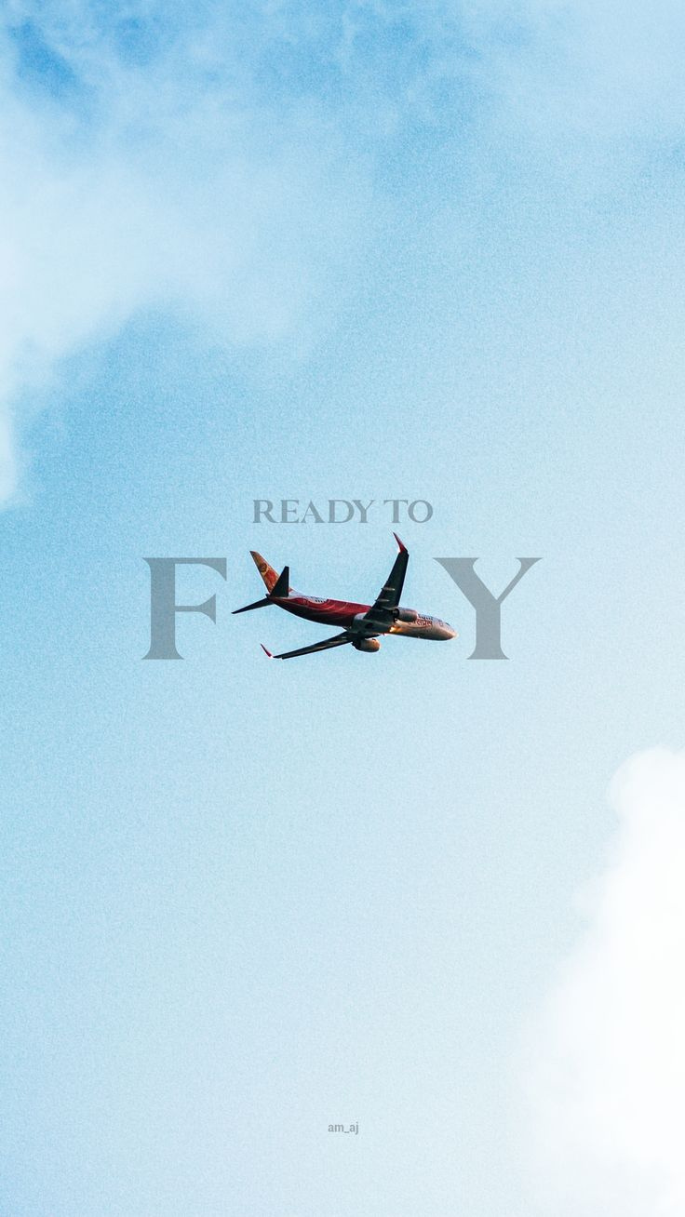
NLA Airlines
ANY QUESTIONS?

Slide 24


NLA Airlines
THANK YOU!

